Slide 1
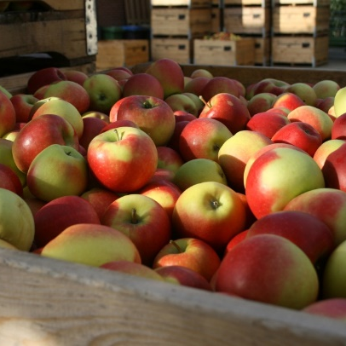
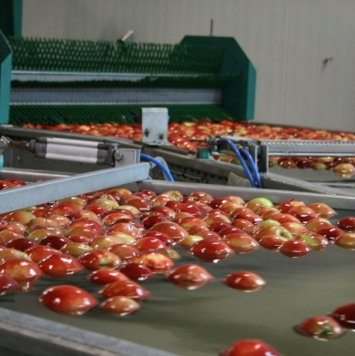

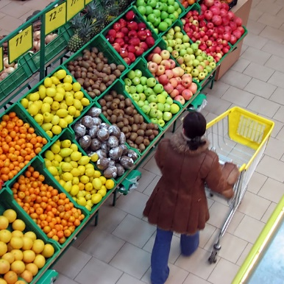

Automatic DCS for the best quality
Excellent firmness, long shelf live,
Protection against scald, pit rot, skin spot,
Alternative for smartfresh,
Natural ripening, excellent taste.

Slide 2
The advantages of DCS
Maximum reduction of scald, skin spots and pit rot
Better firmness, better shelf life
Non chemical treatment
Natural ripening after storage, better taste
Better appearance of the product
DCSTM represents a quality label
DCS can be used as an alternative for smartfresh / or be used in combination with smartfresh.
Guarantees on freshness and quality can be realized on a better way.

Slide 3
What is Automatic DCS?
It provides an automatic system for daily accurate measuring of the ethanol production on a ppb level of a sample of fruit.
The fruit can be stored at the lowest O₂ level where fermentation will not start.
Storing fruit at the lowest O₂ level will provide the best fruit quality;
Measuring fluorescence, respiration or other indirect factors provide indirect, less accurate information

Slide 4
Why automatic DCS?
Ethanol is the
only direct
marker for DCS/ DCA storage
(other markers are working indirect for indicating fermentation.)

Slide 5
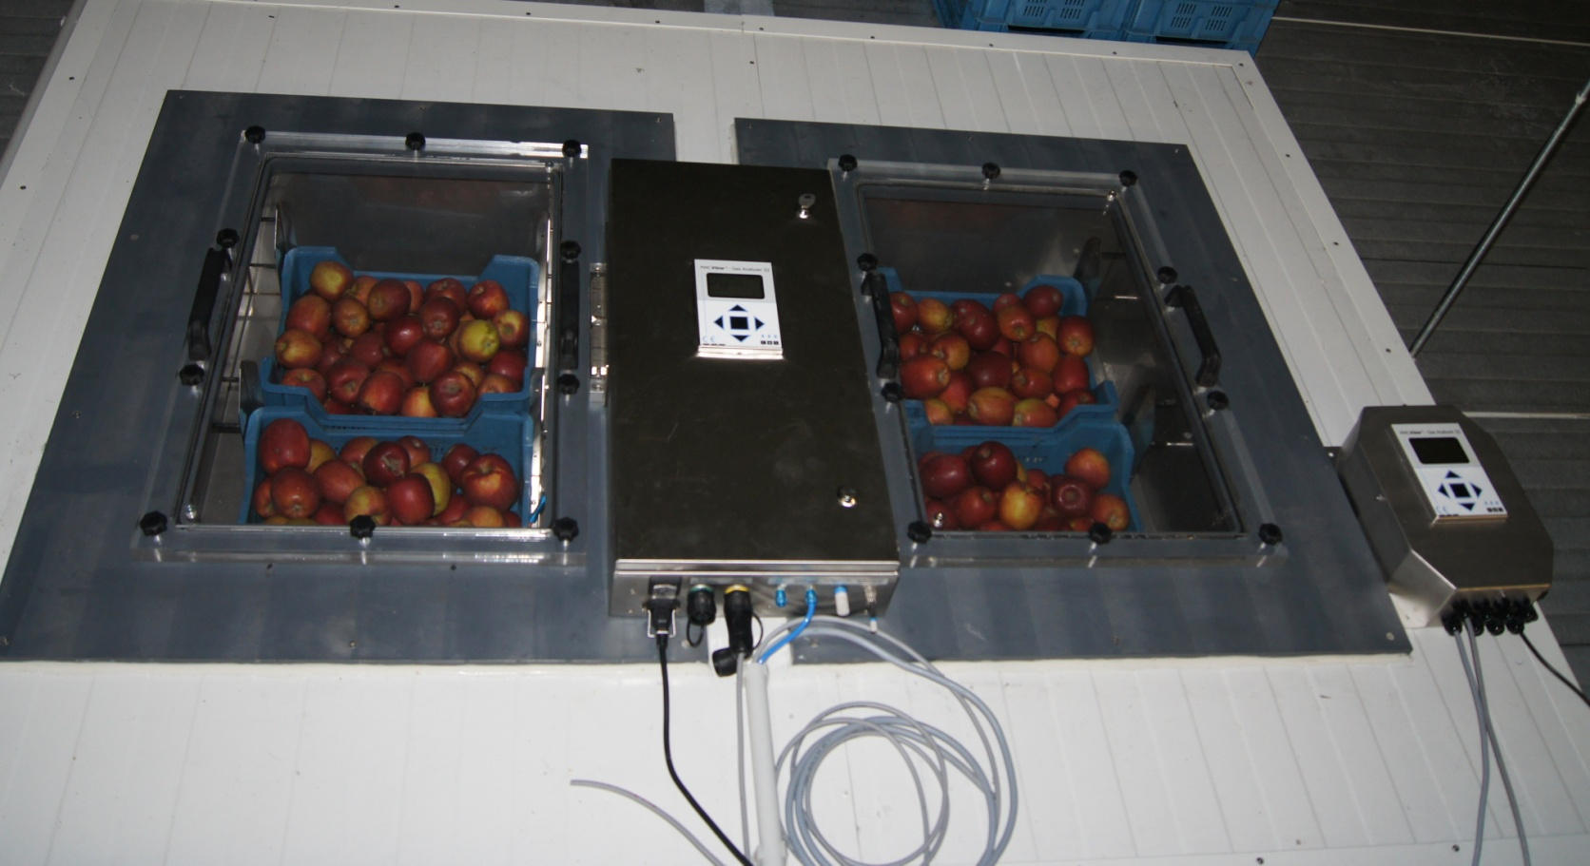
2 pc. Measuring boxes with gasanalyser connected on 2 rooms

Slide 6
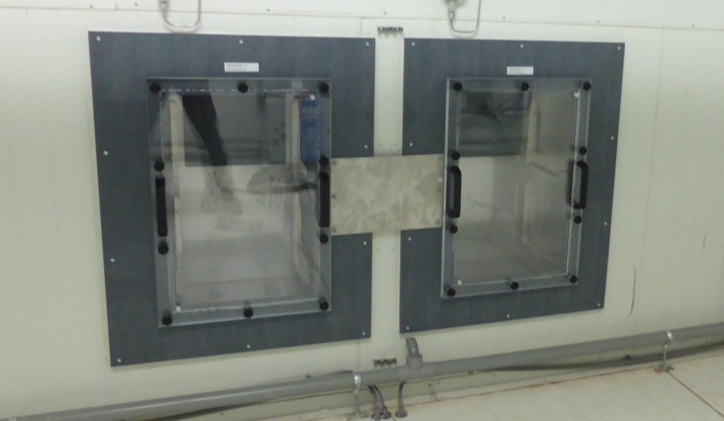
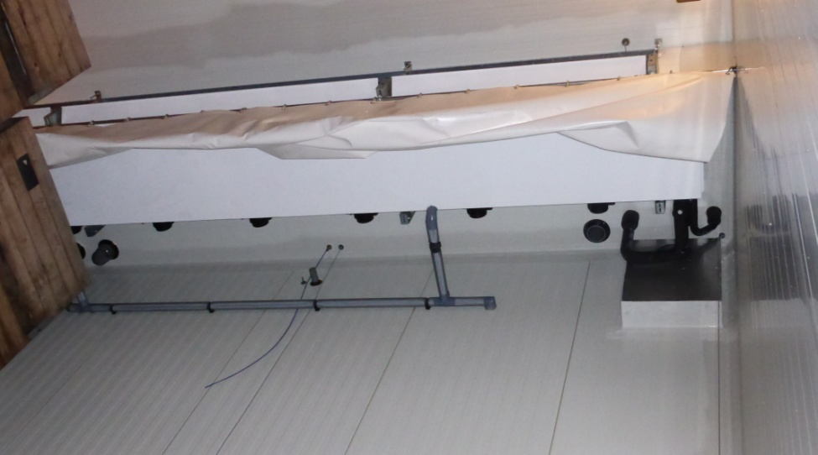
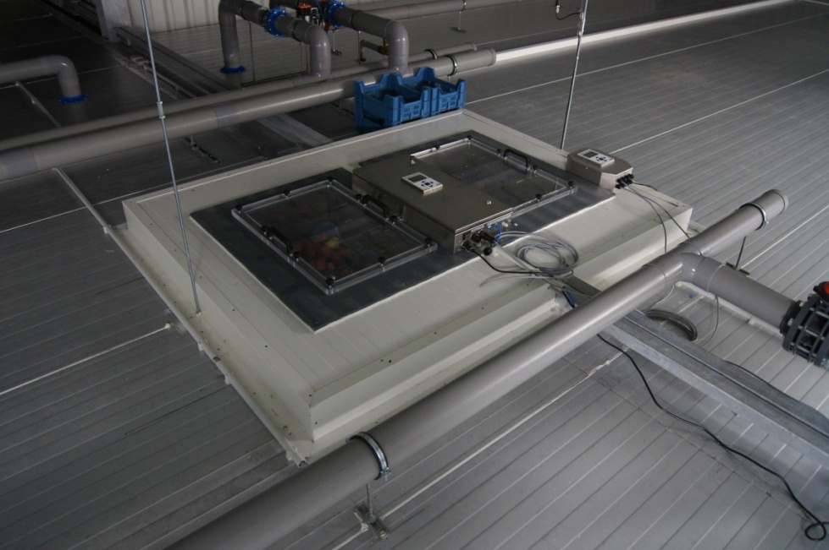
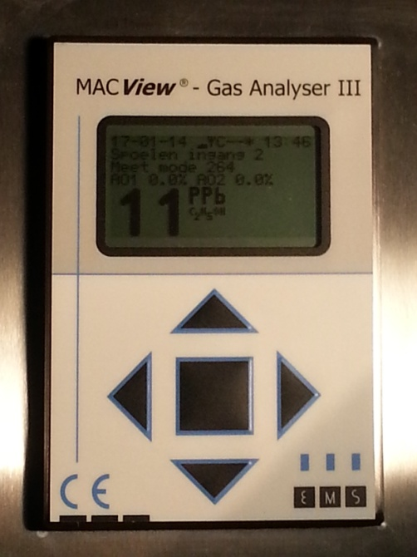
Installation of measuring boxes

Slide 7
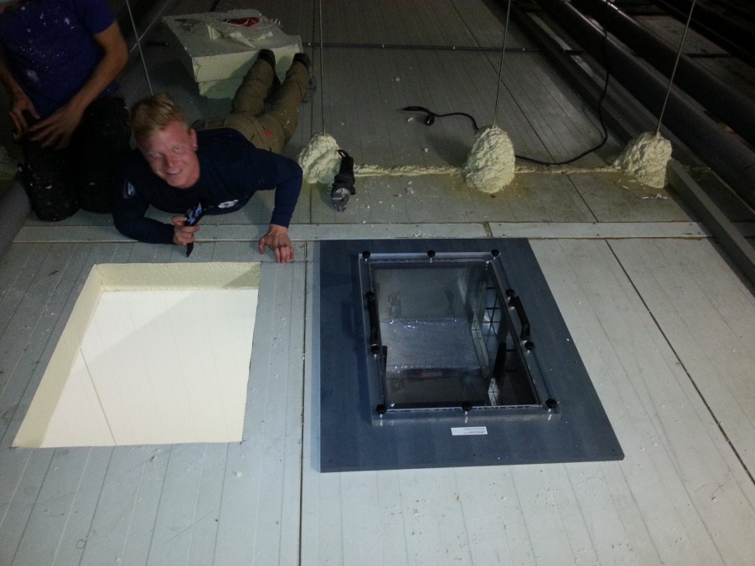
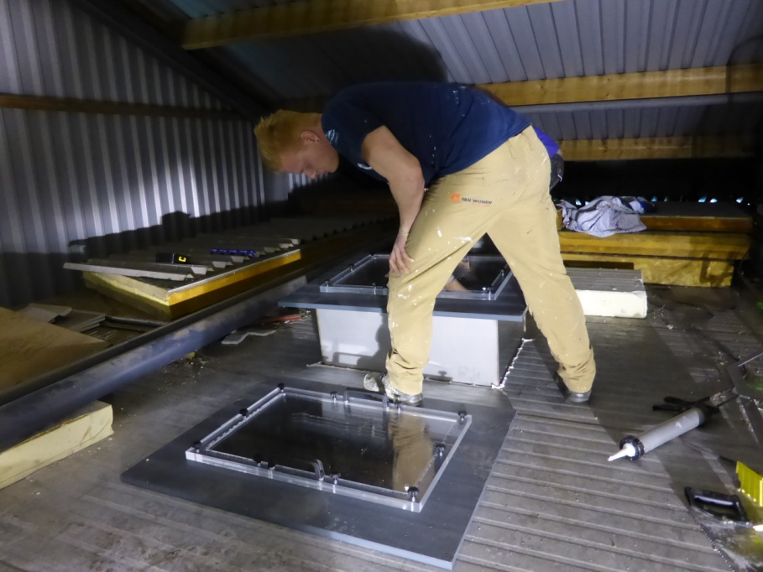
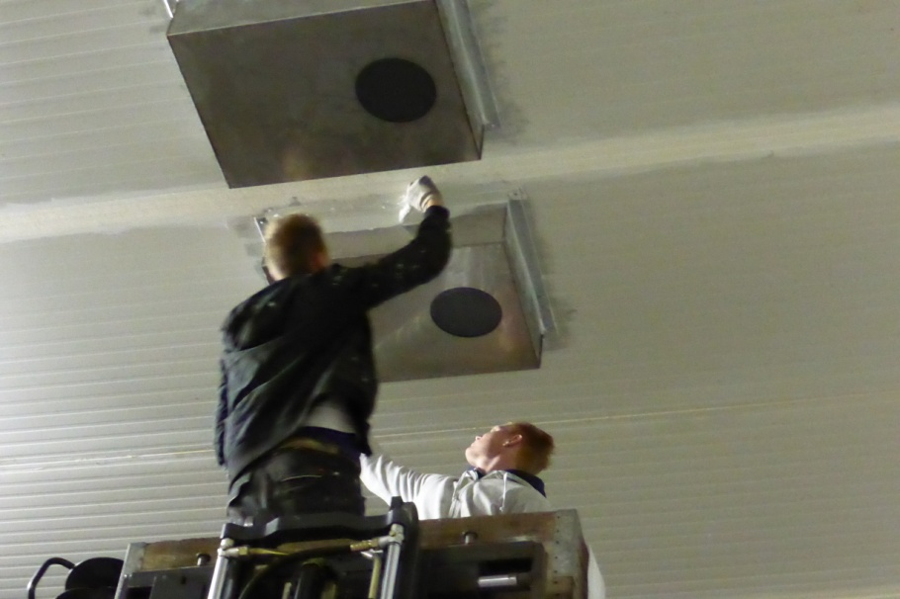
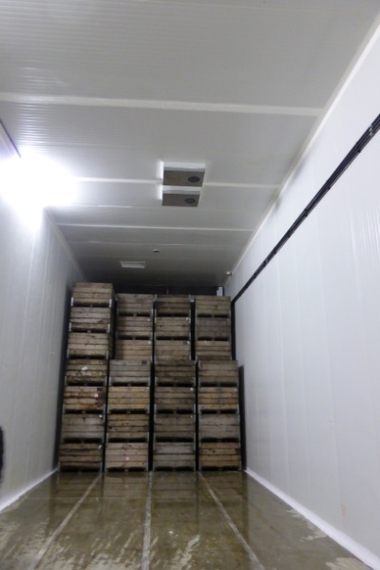
Installation of measuring boxes

Slide 8
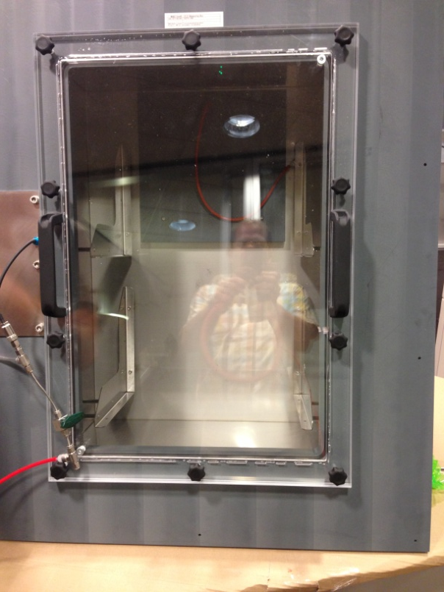
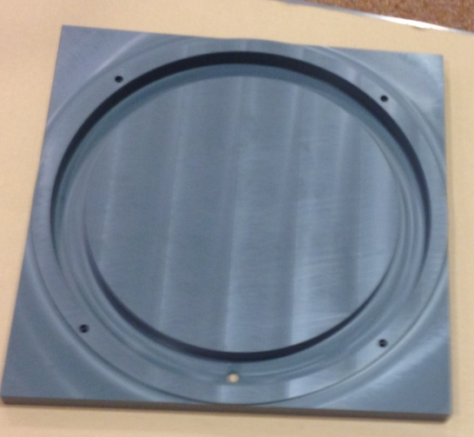
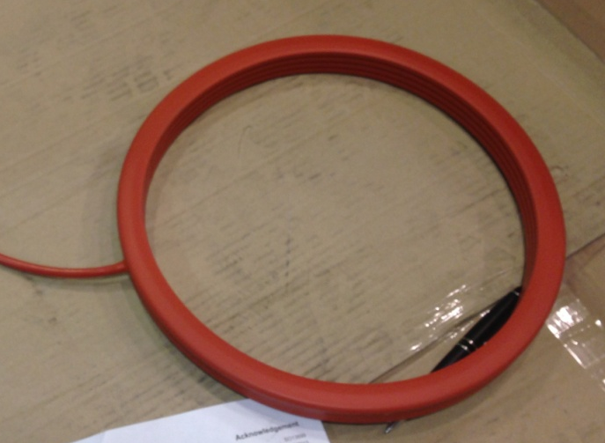
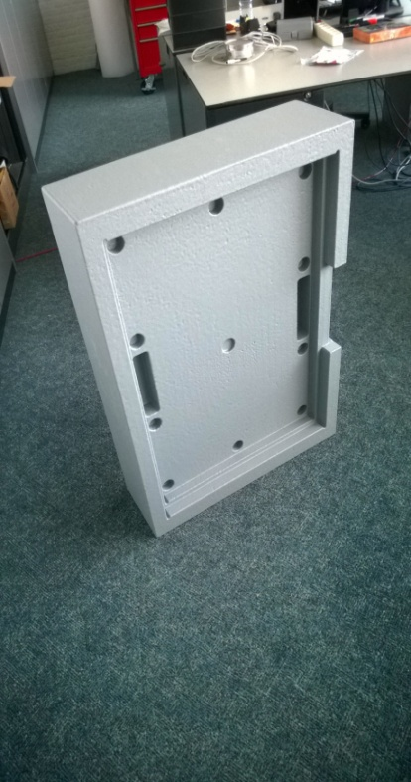
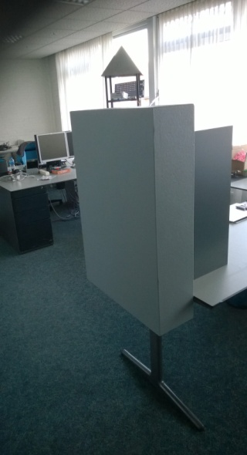
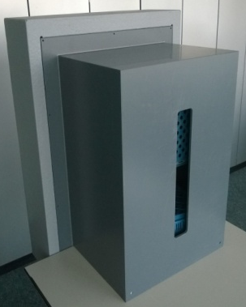

Ventilation opening

Slide 9
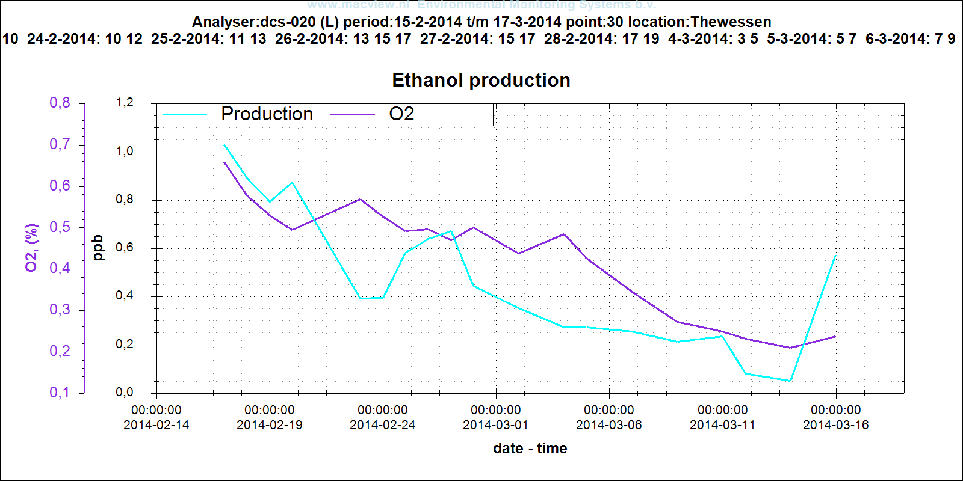
How does it work
5. The graph shows a clear picture of the trend of the ethanol production of the sample per day. The daily reports gives the operator essential information for safe and reliable storing fruit at the lowest O₂ levels.

Slide 10
How does it work
5. The operator will maintain, reduce or increase the O₂ level in this CA store depending on the strategy and the measurement results.
6. Relevant information of the fruit stored in the DCS room is stored in a web based portal and is easy accessible for the operator and his staff, the consultant and the supplier. Relevant information can be added to this database and consulted by this persons.

Slide 11
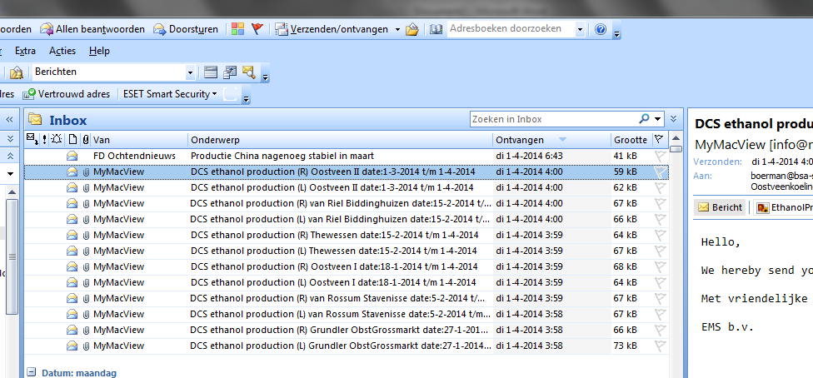
The system sends each day an email with the measured ethanol and O₂ values

Slide 12
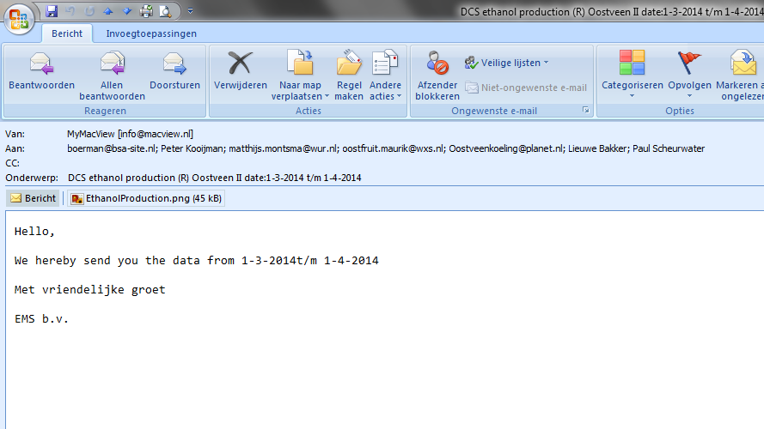
How the day starts with DCS

Slide 13
Example ethanol production
The O2 level is ca. 0,2%. The Ethanol production rises to 0,6 ppb, which is still rather low.

Slide 14
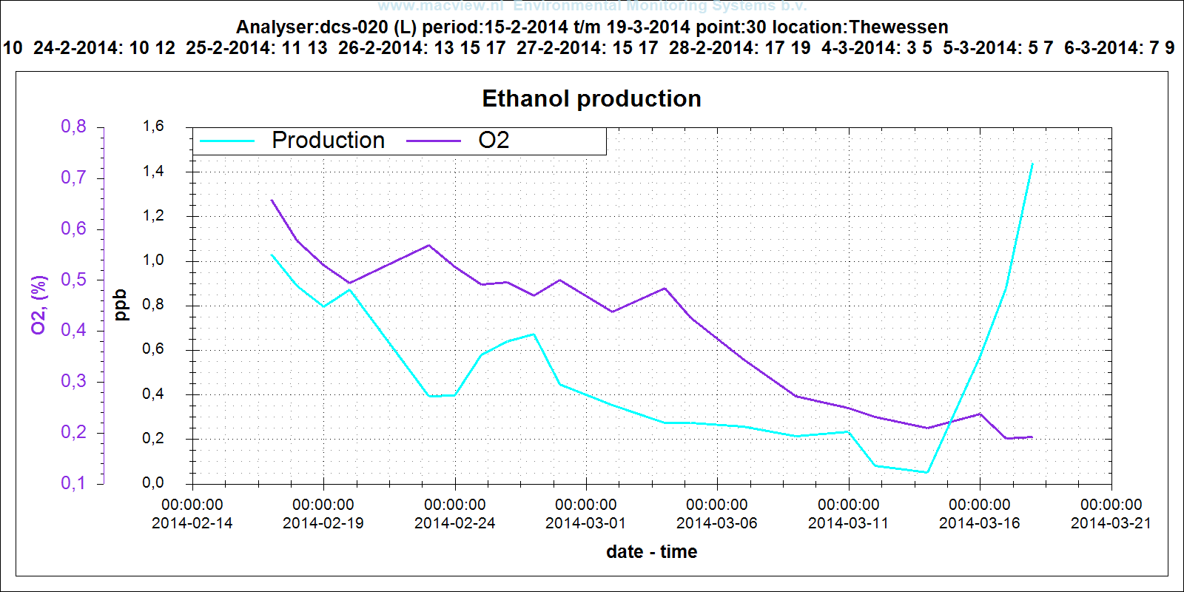
Example ethanol production
A further increase to 1,4ppb.

Slide 15
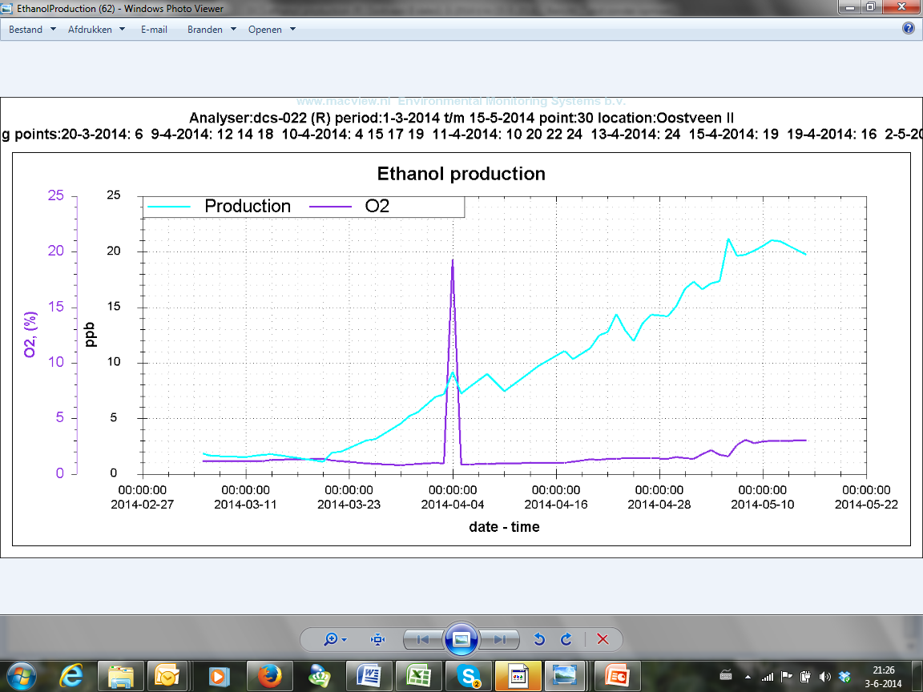
Example ethanol production
We did 3x an fruit flesh analyze. At 2-3 ppb ethanol there was no ethanol present. At 8 ppb there was 8 mg Ethanol/100 gr. fruit flesh, at 20 ppb we measured ca. 17 mg ethanol / 100 gr. fruit flesh.

Slide 16
Characteristics
The lowest O₂% will vary;
per origin / variety
Per season
The lowest O₂% can change during the storage season. (dynamic)

Slide 17
Characteristics
A daily and reliable report about the ethanol production of your fruit.
Daily protection/security for the storage of your fruit on the lowest oxygen levels.
Automatic DCS can be used as:
A watchdog system
A dynamic system for storage at the lowest oxygen levels

Slide 18
Characteristics
Measuring ethanol provides the only direct measured value for indicating the lowest O₂% where at fermentation starts.
Ethanol is the best marker for fermentation.

Slide 19
Extra advantages of Automatic DCS
Faster to the lowest oxygen levels
In comparison with all others systems: a daily control on ethanol production of the fruit at de lowest oxygen levels.

Slide 20
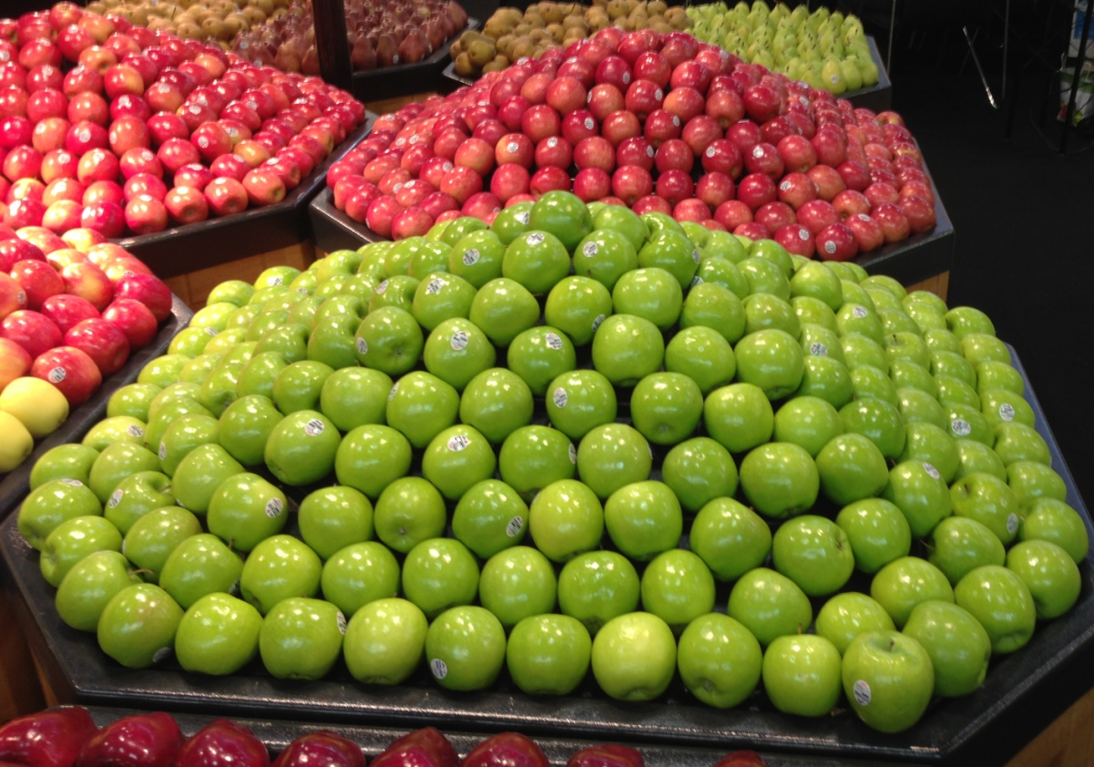
Extra advantages of Automatic DCS
The best fruit quality after storage is archieved by storage at the lowest oxygen levels (source: FBR Wageningen)

Slide 21
Facts about DCS
DCS and Automatic DCS are researched for years and has proved themselves
After the introduction of DCS in 1997, alternative systems are introduced below the name of DCA (Dynamic Controlled Atmosphere)
DCS gives in comparison with the normal ULO storage systems better results.
DCS can be used as a alternative of Smartfresh, or in combination with Smartfresh

Slide 22
History of DCSTM
DCS is developed and introduced by Wageningen UR, Food & Biobased Research, Netherlands since 1997.
Since 1997 more than 15 years of research
DCS is applied in ca. 200 cells.
DCS is applied in ca. 200 cellen. Checking the apples on the presence of ethanol is carried out manually by a pulp analysis
When there is no ethanol measured, the oxygen level can be decreased. When ethanol is measured the oxygen level has to increase. Dynamic storage.

Slide 23
History of DCSTM
A number of attempts to automate the DCS system has failed
Due to the labour-intensive method, the semi automatic DCS application is used very limited. This despite the enormous advantages
Due to the labour-intensive DCS storage, most oxygen values aren’t reached as soon as possible
Automic DCS makes it possible to control and reach the oxygen levels quickly
DCS improves the quality of the fruit by long term storage.

Slide 24
DCS - History
Before automatic DCS, there was no reliable measurement for ethanol in a cold store. Why?
Ethanol has to be measured on ppb scale
Measuring ethanol is difficult, because of the presence of, for example ethylene and other gasses.
Ethanol dissolves easily in water
Also rotting fruit produces ethanol
Because of the developed procedure with the measuring box this problems haven been solved.

Slide 25

History of the DCS Automatic
Since 2009 there is a cooperation between:
Wageningen UR, Food & Biobased Research, Nederland
Storex B.V.
EMS B.V. ( Manufacturer of analytic sensor technics)
Since 2009 we have devolped the Automatic DCS system, based on new developed sensor technics
Since 2013 the system is ready to be used

Slide 26
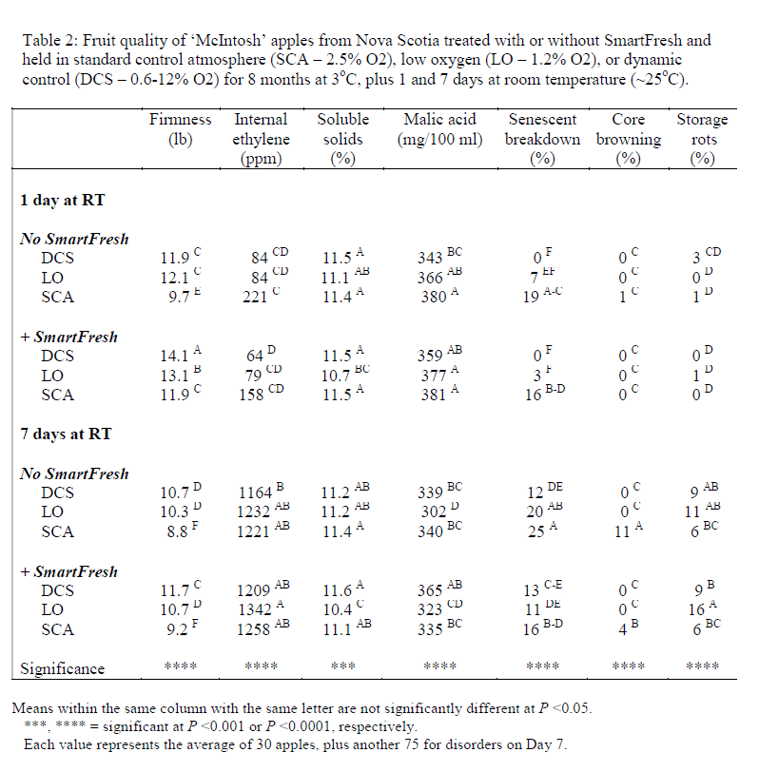
Research results
Remarkable results of research in Canada 2013/2014 with McIntosch
After 7 days on room temperature, apples stored with DCS maintain the same firmness as apples stored with ULO and Smartfresh.

Slide 27
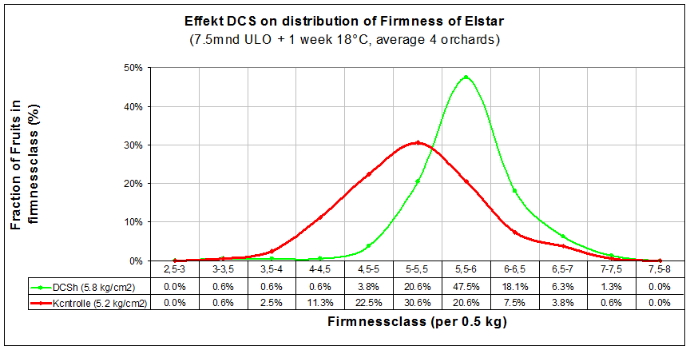
Firmness ULO versus DCSTM
Elstar

Slide 28
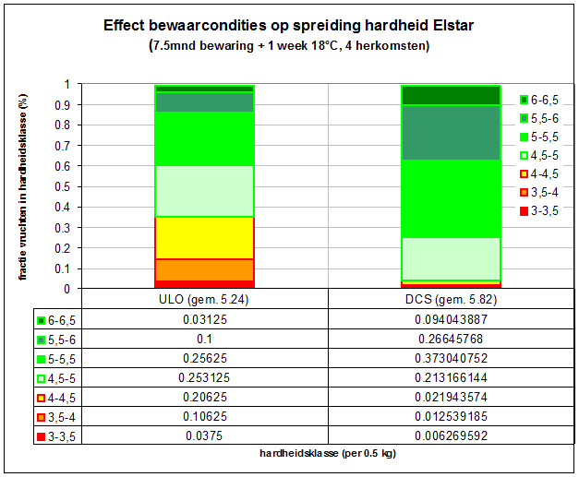
Distribution of firmness ULO versus DCSTM

Slide 29
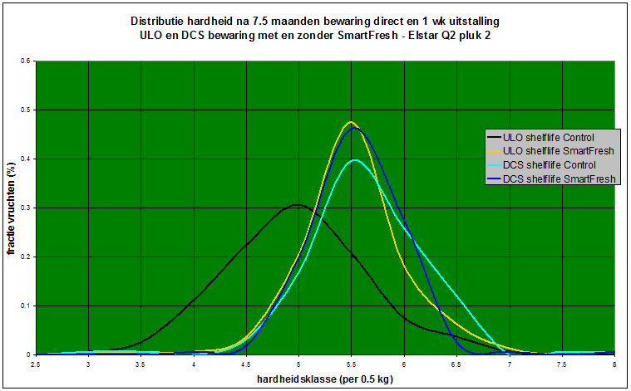
DCSTM versus SmartFresh
Firmness distribution after 7,5 months storage and 7 days shelf
ULO and DCS storage with and without SmartFresh – Elstar Q2 H2
Fruit fraction %
Firmnessgrade (per 0,5) kg))

Slide 30
Scald control

Slide 31
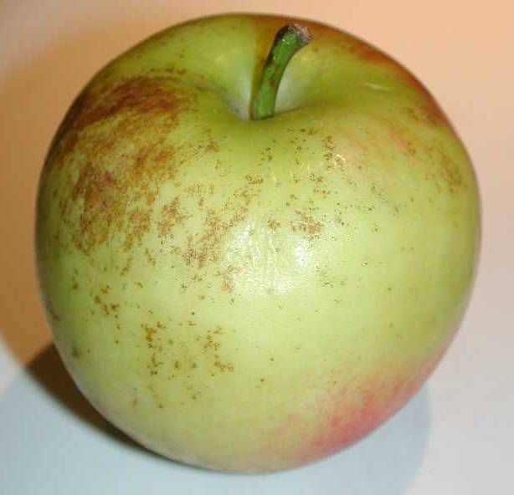
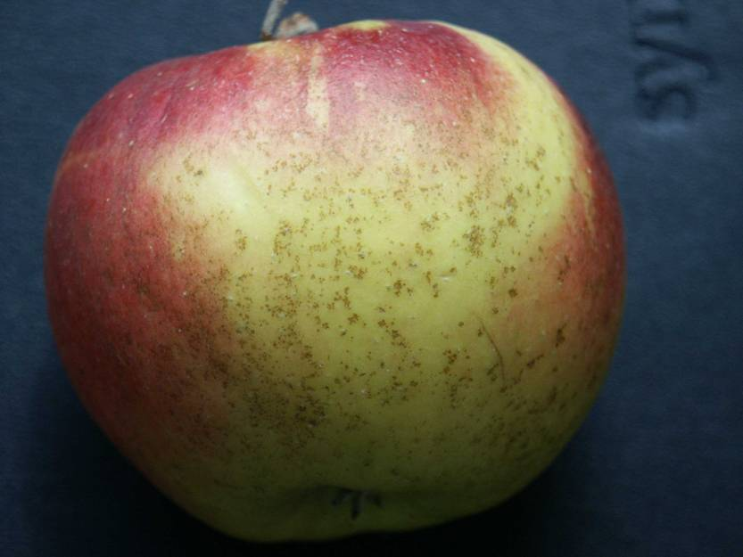
Reduction of schil spots

Slide 32
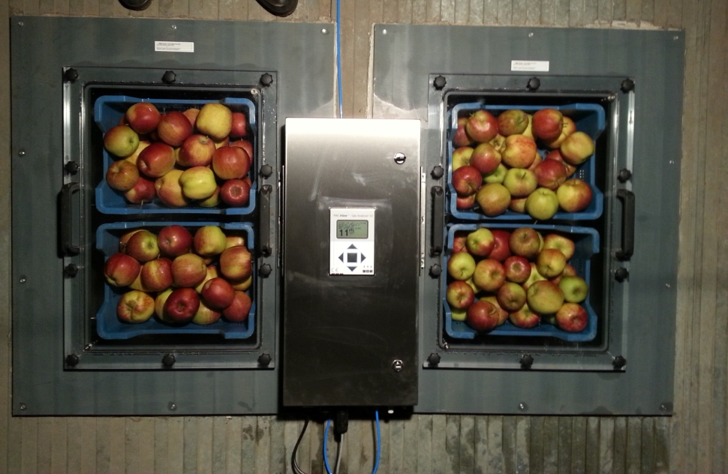
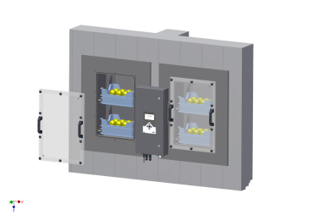

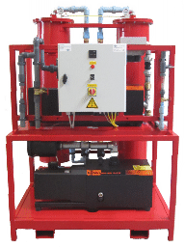
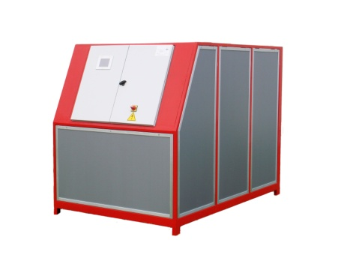
Configuration
DCS ANALYZER
DCS Sample box
O2 / CO2 SENSORS
ETHANOL
DATA-LOGGING
O2 / CO2 CONTROL
OPTIMAL O2

Slide 33

DCSTM components
The sample boxes
Two pieces of solid sample boxes
Transparant perspex lid for visual inspection and accessibility
Sample boxes can be built into the ceiling and side wall of the cold store
Equipped with a ventilation opening which can be closed with a membrane

Slide 34
Automatic DCS is now available
Automatic DCS is now available to use.
The offer in 2014 consists for each system:
2 pc. of sample boxes
The DCS ethanol measuring system
A license-free use of the system
When you are interested, we would be happy to plan a meeting with you. During this meeting we will make the DCS system available for your company. So you can benefit of the advantages of the DCS system.

